Slide 1
AI Pitch Kit

Slide 2
Ethics in AI

Slide 3
“The most critical next step in our pursuit of AI is to agree on an ethical and empathic framework for its design.”
—Satya Nadella
Notes:
http://www.slate.com/articles/technology/future_tense/2016/06/microsoft_ceo_satya_nadella_humans_and_a_i_can_work_together_to_solve_society.html

Slide 4
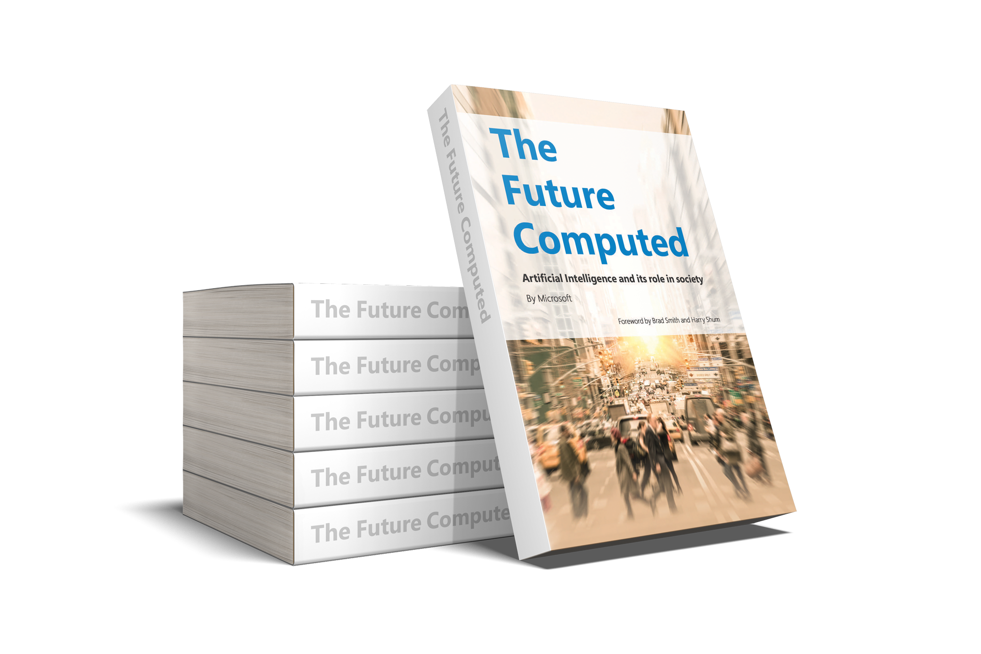

Design AI responsibly
Drive
Fairness
Reliability
and safety
Privacy and security
Inclusiveness
Transparency
Accountability
Partnership on AI
Set of companies Tech Industry and outside that has come together to formulate best practices and principles around the engagement and influence of AI on people and society
Defining the principles to AI
How to design AI Systems Responsibly?
What principles do we need to protect people?
How do we Govern AI’s use?
Impact of AI on Economies and Jobs?
To avoid
Bias
Evolve
Good use
Accessibility
Consent & Explanation
Responsibility
Progress to date:
Internally established Aether board
Industry: Partnership on AI, OpenAI, AI Now Institute
news.microsoft.com/futurecomputed

Slide 5
AI isn’t just another piece of technology. It could be one of the world’s most fundamental pieces of technology the human race has ever created.
–Satya Nadella
“Today we don’t think of aviation as ‘artificial flight’—it’s simply flight. In the same way, we shouldn’t think of technological intelligence as artificial, but rather as intelligence that serves to augment human capabilities and capacities.”
–Satya Nadella

Slide 6
What is AI?

Slide 7
What Microsoft means by AI
AI is not static, it learns and thinks
AI amplifies human capabilities
AI will assume job tasks, not necessarily eliminate the job
The immediate impact of AI is outstanding
Of customer interactions powered by AI bots by 2025
Applications to include AI by the end of this year
Of enterprises using
AI by 2020
95%
75%
85%
Conversational Agents
Transform your engagements with customers and employees
Intelligent Apps
Leverage AI to create the future of business applications
Business Processes
Transform critical business processes with AI

Slide 8
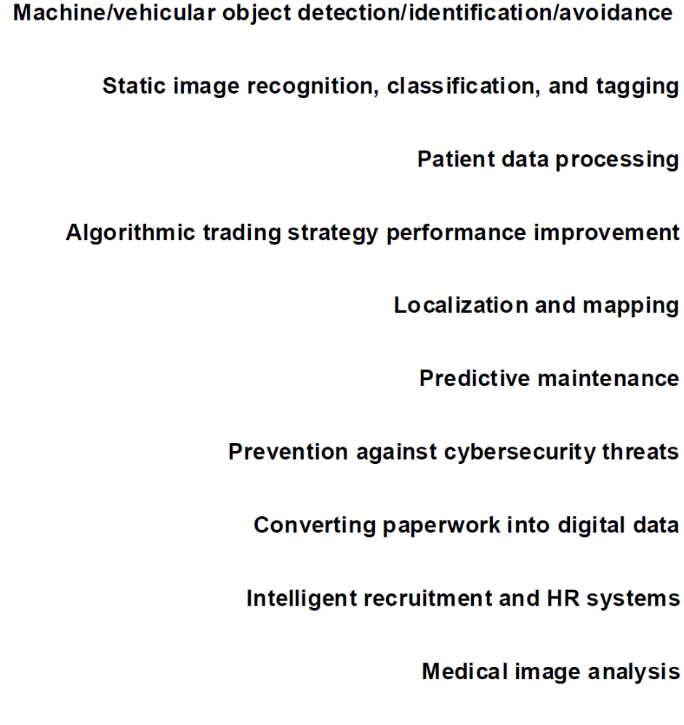
What specific use cases should you start with?
0M
2M
4M
6M
8M
10M
Source: Tractica 2017 Artificial Intelligence Market Forecasts

Slide 9
Azure AI
AI apps & agents
Knowledge mining
Machine learning
Azure Bot Service
Azure Cognitive Services
Azure Cognitive Search
Azure Databricks
Azure Machine Learning
Azure AI infrastructure

Slide 10







Azure is the best place for AI
Accelerate time to value
with agile tools and services
Innovate with AI everywhere
in the cloud, at edge and on-premises
Use any language, any development tool and any framework
Benefit from industry leading security, privacy, compliance, transparency and AI ethics standards
>90% of Fortune 500 companies use Microsoft Cloud
Pretrained AI services
Powerful
tools
Comprehensive
platform
Cloud
Edge
On-premises

Slide 11
Cognitive Services
Bot Service
Infuse your apps with powerful, pre-trained AI models
Customize easily and tailor to your needs
Train in the cloud and deploy anywhere
Accelerate bot development with an integrated environment and pre-built templates
Engage your audience easily across multiple channels
…
Vision
Speech
Language
Search

Slide 12
Building AI apps & agents
Vision
Speech
Language
Your Apps

Slide 13





Microsoft Cognitive Services
Vision
Computer Vision
Content Moderator
Emotion
Face
Video Indexer
Speech
Bing Speech
Speaker Recognition
Language
Bing Spell Check
Linguistic Analysis
Text Analytics
Translator Text & Speech
Web Language Model
Knowledge
Academic Knowledge
Entity Linking
Knowledge Exploration
Recommendations
QnA Maker
Search
Bing Autosuggest
Bing Image Search
Bing News Search
Bing Video Search
Bing Web Search
Bing Entity Search

Slide 14
What is knowledge mining?
Unlock valuable information lying latent in all your content
Form 5471

Slide 15
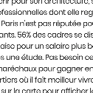


Knowledge mining with Azure Search
Documents
Cutting-edge AI
Fully text-searchable rich index
Key Phrase extraction
Location entity extraction
Sentiment analysis
Organization entity extraction
Persons entity extraction
Language detection
Face detection
Celebrity recognition
Tag extraction
Custom skills
Landmark detection
Printed text recognition

Slide 16






Machine learning on Azure
Sophisticated pretrained models
To accelerate solution development with easy to use pretrained models
…
Vision
Speech
Language
Search
Cognitive Services
Popular frameworks
Build sophisticated deep learning solutions
Pytorch
TensorFlow
Keras
Onnx
Productive services
Empower your development teams
Azure Databricks
Azure Machine Learning
Machine Learning VMs
Powerful infrastructure
Accelerate time to value
CPU
GPU
FPGA

Slide 17
Evolving an AI practice
Vertical specialization
Provide packaged, industry specific AI solutions
AI Algorithms
Design and implement custom algorithms. Deep algorithmic understanding
AI Modeling
Train and deploy models using customer data
Start
Integrate AI APIs, Chat Bots
Leverage pre-built AI APIs, as well as Chat Bots in solutions

Slide 18




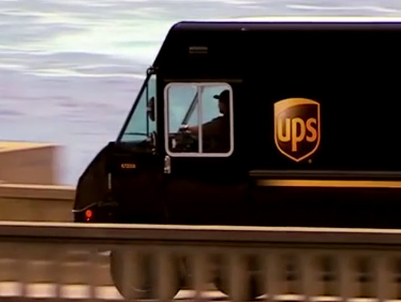

Chat Bots
Pre-trained AI API
“By using Microsoft Azure Bot Service and Cognitive Services … we've been able to continue our own Progressive journey of digital innovation and do it in an agile, fast, and cost-effective way.”
“Within five weeks, we had developed a chatbot prototype with the Microsoft Bot Framework… Our Chief Information and Engineering Officer loved it and asked that we get a version into production in just two months…and that’s just what we did.”
“Thousands of partners sign in to our platform every hour. The response time from the Face API is incredible, enabling us to verify our drivers without slowing them down.”
Matt White
Marketing Manager, Personal Lines Acquisition Experience, Progressive Insurance
Kumar Athreya
Senior Applications Development Manager of Shipping Systems, UPS
Dima Kovalev
Product Manager, Uber
Azure Bot Service
Bot Framework, Language
Understanding Intelligent Service (LUIS)
Face API
Read case study here
Read case study here
Read case study here
See video here
Notes:
Summary
Major auto insurance provider Progressive Insurance may be best known for Flo, its iconic spokesperson. The company wanted to take advantage of customers' increasing use of mobile channels to interact with its brand. So Progressive used Microsoft Azure Bot Service and Cognitive Services to quickly and easily build the Flo Chatbot—currently available on Facebook Messenger—which answers customer questions, provides quotes, and even offers a bit of witty banter in Flo's well-known style.
Challenge
Progressive is one of the largest auto insurance suppliers in the United States. And it has been selling auto insurance directly to customers on the internet since 1997—so the company has experience watching the online space evolve and grow. As mobile has become a more important channel, Progressive has looked for ways to use it to connect with customers who want easy, personal, and trustworthy digital experiences. The company knew that customers spent a lot of time in messaging apps, so it looked for a way to let them get quotes and get questions answered in that context.
Solution
Progressive used Microsoft Azure Bot Service and Cognitive Services APIs to build the Flo Chatbot, patterned after the company’s popular and iconic spokesperson. The Flo Chatbot—currently available through Facebook Messenger on Flo’s Facebook page—provides a conversational interface through which customers can ask questions about insurance, get a quote, and even pose personal queries.
Benefits
With Bot Service, Progressive put together the basic framework for the bot with out-of-the-box functionality.
Cognitive Services APIs also provide the ability for a knowledge base to grow and learn more over time, so the responses keep getting better and better.
Updating the bot’s dialogue models is so easy that it gives customers a new level of speed and agility.
https://customers.microsoft.com/en-us/story/progressive-insurance-cognitive-services
-----------------------------
Summary
Millions of people worldwide have embraced Uber as a new means of reliable transportation and flexible income. To safeguard against fraud and enhance both driver and rider peace of mind, Uber uses the Face API, part of Microsoft Cognitive Services, to help ensure the driver using the app matches the account on file. The extra verification step is fast, works on all smartphones and in dim light, and scales to more than 1 million driver-partners. By using the Face API, Uber saved months of development work, time it could devote to tailoring the user experience.
Challenge
Uber sends photos of drivers to riders as soon as their ride is on the way, but occasionally the Uber driver who shows up doesn’t look like the person in the photo that the rider receives. Uber wanted to make sure that the person it had screened and approved was the person behind the wheel.
Solution
Uber decided to use photo-matching to verify drivers when they signed in to the Uber app. Drivers would periodically take and submit a selfie to verify their identity. Uber used the Microsoft Cognitive Services Face API to build its Real-Time ID Check feature. The Face API supported the ability to compare photos in varying pose, focus, and lighting conditions.
Benefits
Three-week development time and rapid time-to-market with new driver authentication step
Amazing performance, which provides quick authentication without slowing down drivers
Very high photo-matching accuracy
Scalable to support up to 1 million users
https://customers.microsoft.com/en-US/story/uber

Slide 19

Lost package finding systems based on cognitive services
NEED
Everyday this company transports ~13M packages.
Of those, approximately 3,000 don’t make it to their destination for various reasons such as bad labels, packaging or damage.
The team in charge of lost packages can recover 45% but they wanted more.
TECHNICAL SOLUTION
Use Cognitive APIs such as Vision to search from pictures of the “lost” items as well as improve upon the matches via advanced text analysis segmenting the problem by attribute.
Search Example:
Color (Black)
& Texture (Smooth)
& Category (Electronics)
-> It might be a cell phone
Vision API
Vision API
Text API
Custom API
Custyom API
Color
Texture
Entity
Word2Vec
Future 1
Model
Model
Extraction
Azure ML Workbench
Cognitive Services APIs
Models
User
Phone
Found Item
Submitted from Field
App Service
Storage blob
User
website
(generic)
Enhanced Info Posted
DocumentDB
Azure
Search
Microsoft
Azure

Slide 20

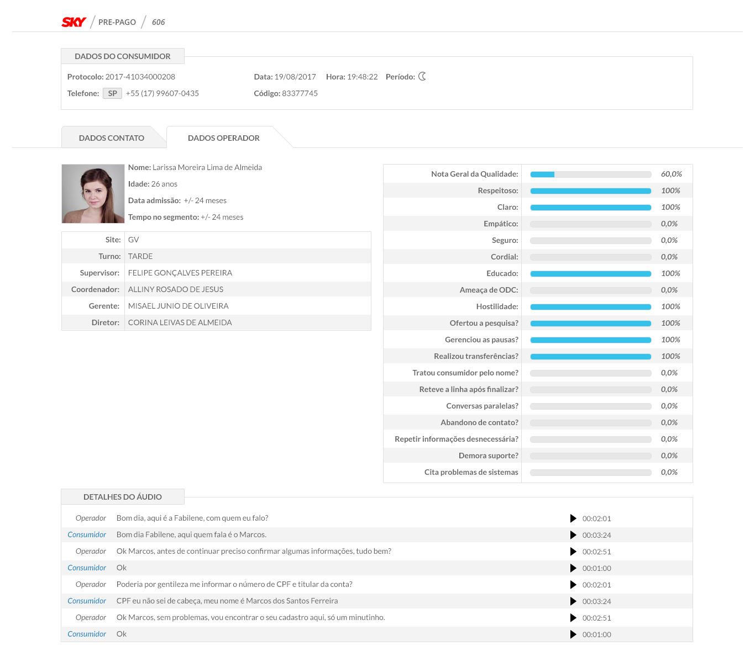
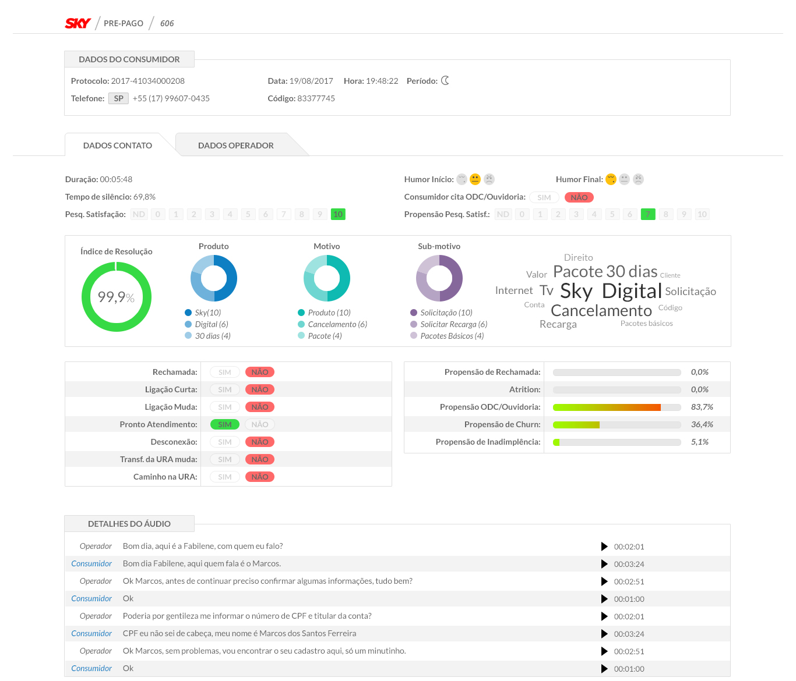
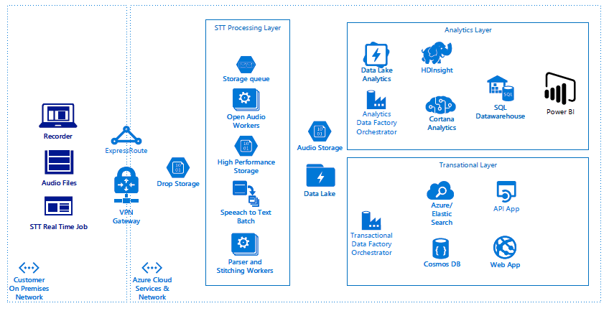
Analytics for calls of Contact Centers company with 90K+ Customer Agents
NEED:
Extract full text from low quality audios generated by IVR.
SOLUTION OFFERING:
Audio files are compressed in a proprietary format and uploaded onto Azure. Once in Azure, we have built an open architecture to process this audio (merge different audios together). Transcribed the call, send data to a data lake and the analysis and predictions.
Queue controlling this process to automate as much as possible.
BENEFITS:
Other vendors have similar solutions but:
They use a small subset of the calls.
Detect an agent who is not cordial enough, or is not following a script. …and so on.
The insights help on boot creation, agent ranking and training among others.

Slide 21
Banking loan origination
Need
A large banking client collects and discards annually 2 TB of public records data. This information is to be coupled with internal data to assist the loan underwriter in analyzing loan origination.
Envisioning
Developed a roadmap that coupled demographic data with the bank’s current loan origination process to give local loan underwriters better intelligence and reduce risk of default when evaluation loan applications.
Technical solution
Collect multiple years the data into the Data Lake Store and use Azure Machine Learning with Power BI to evaluation the loan origination process.
Envisioning

Slide 22
Cross-selling/upselling
Need
A corporation having 25,000 customers and 4,000 products wants to determine how to better target the propensity of customers to buy their products.
Envisioning
Evaluated client’s current processes centered on their customer and product base to determine how to surface new cross-selling and upselling opportunities.
Technical solution
Collect sudtomer, product, marketing and sales data into Data Lake Store and use Azure Machine Learning to predict opportunities, couple them with Power BI to visualize and drive automation with Dynamics 365.
Envisioning

Slide 23
Operationalize your practice

Slide 24
On-premises versus cloud
Database versus files
Streaming versus batch
Low versus high frequency
On-premises versus cloud
Database versus data lake versus …
Small versus medium versus big data
Structured versus unstructured
Data validation and cleanup
Visualization
Data source
Pipeline
Environment
Wrangling, exploration, and cleaning
Business understanding
End
Business understanding
Data acquisition and understanding
Customer acceptance
START
Modeling
Scoring, performance monitoring, etc.
Feature engineering
Model training
Model evaluation
Transform
Binning
Temporal
Text
Image
Feature selection
Algorithms
Ensemble
Parameter tuning
Retaining
Model management
Cross validation
Model reporting
A/B testing
Intelligent applications
Web services
Model store

